Slide 1
Operating Systems
Process Synchronization
Again:4.11.13-19.22-25.29-31.34-36.46.49.50
Liu，Fagui

Slide 2
Content of this lecture
Review
Data Races
Critical regions
Mutual exclusion using busy waiting
Sleep and Wakeup
Semaphores
Mutexes
Monitor
Passing Message
Barrier (屏障）
Classic synchronization problems
Summary

Slide 3
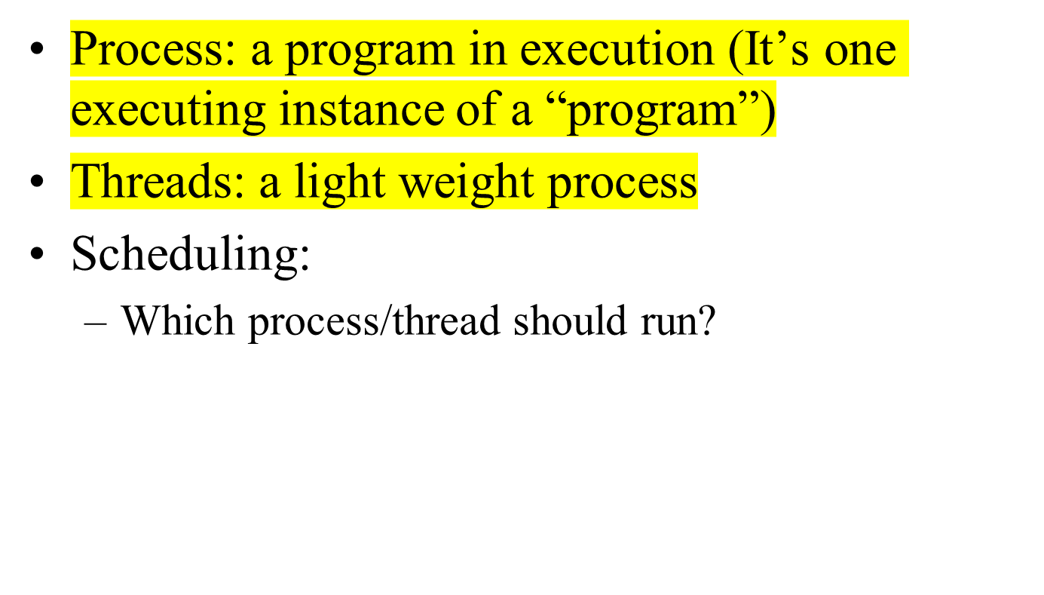
Review

Slide 4
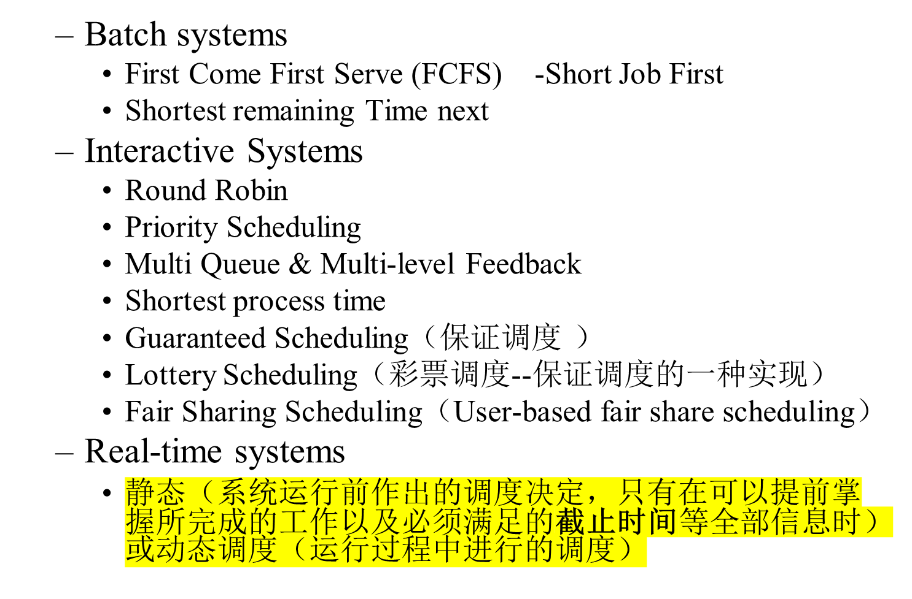
Review 2----CPU Scheduling

Slide 5
Inter-Process Communication (IPC)
1.Communication
  Pass information to each other
2.Mutual exclusion & Synchronization
  Keep each other’s hair
  Proper sequencing
The last one also applies to threads

Slide 6
Data Races(数据竞争)
Reason: data sharing
Previous game: producer and consumer
  Share the counter
  Share the cards
Examples
  Thread:
  Process:

Slide 7

Race Conditions
Figure 2-21. Two processes want to access
shared memory at the same time.

Slide 8
Spooling Example: Correct
Process 1
Shared memory
Process 2
int next_free;
int next_free;
…
out
1
next_free = in;
4
abc
Stores F1 into
next_free;
Prog.c
2
5
6
Prog.n
3
in=next_free+1
in
7
F1
4
next_free = in
F2
5
Stores F2 into
next_free;
…
in=next_free+1
6

Slide 9
Spooling Example: Races
Process 1
Shared memory
Process 2
int next_free;
int next_free;
…
out
1
next_free = in;
4
abc
5
Prog.c
2
next_free = in
/* value: 7 */
Stores F1 into
next_free;
Prog.n
3
6
F1
in
7
F2
4
in=next_free+1
5
Stores F2 into
next_free;
…
in=next_free+1
6

Slide 10
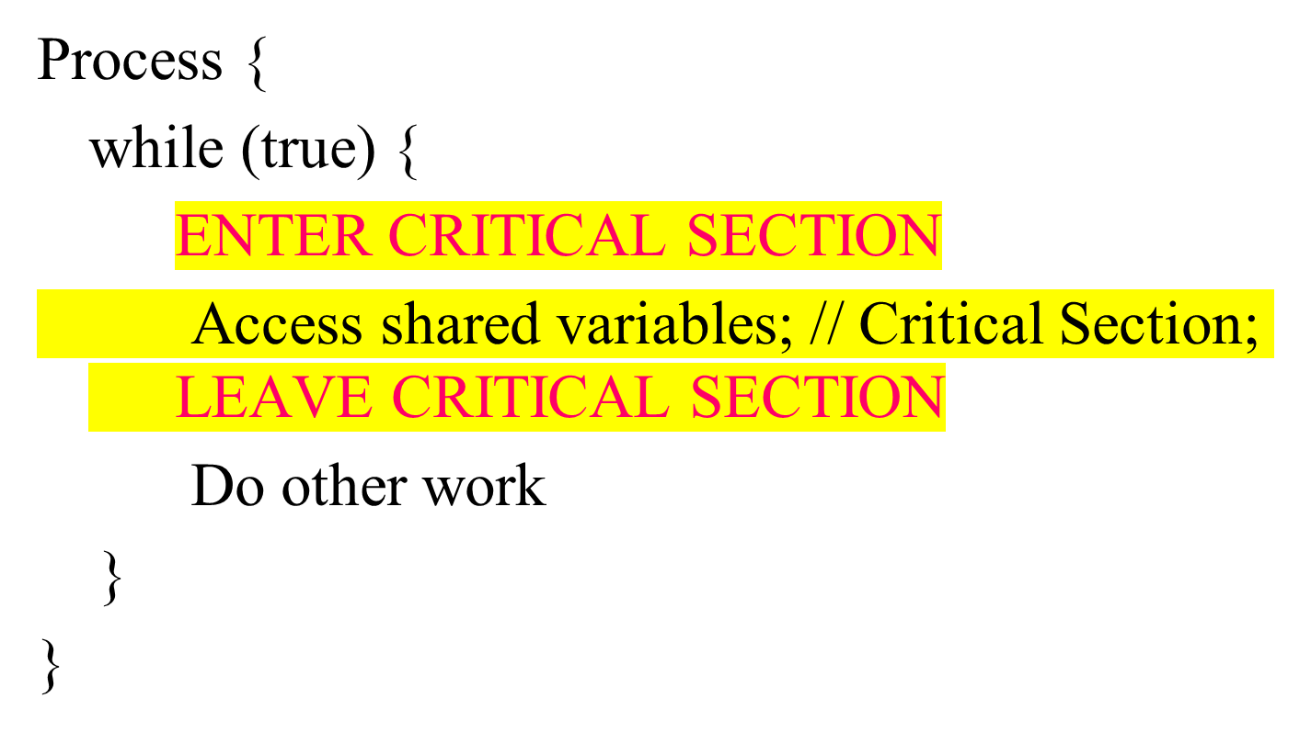
Critical Region (Critical Section)
Critical Section：对共享内存进行访问的程序片段

Slide 11
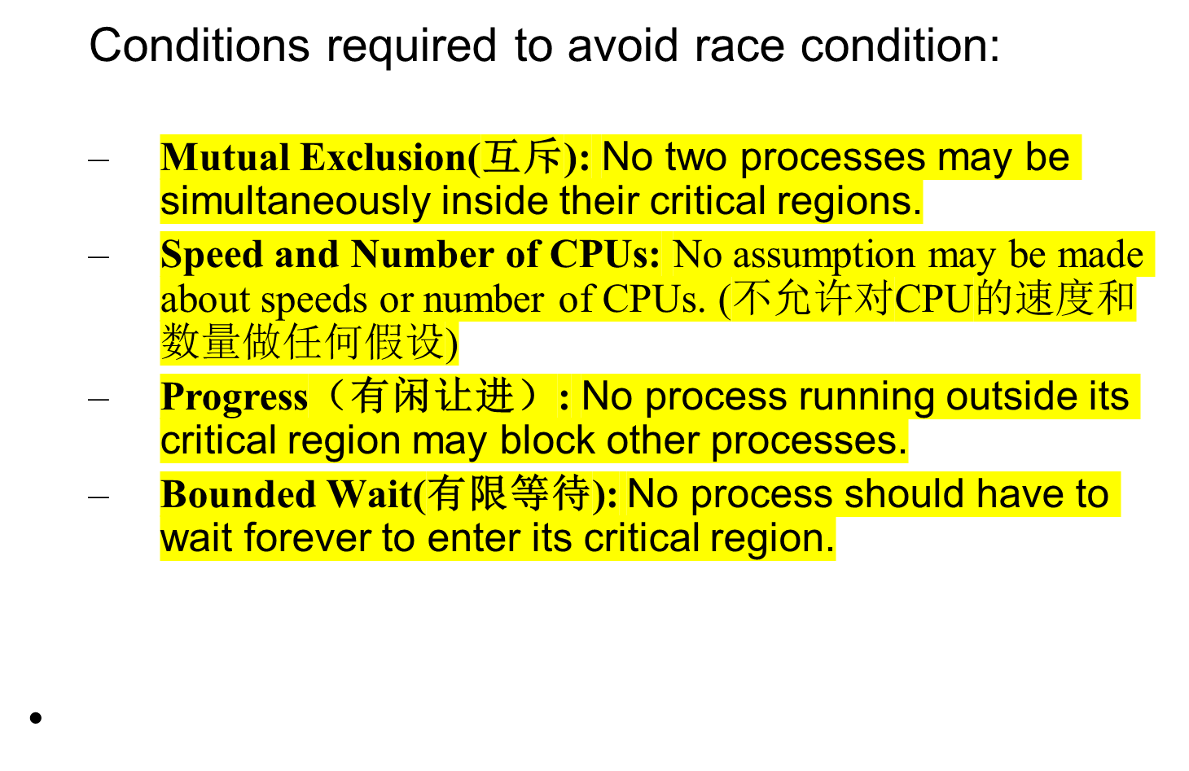
Critical Region Requirement

Slide 12

Critical Regions (2)
Mutual exclusion using critical regions

Slide 13
Mutual Exclusion With Busy Waiting
Possible Solutions
  Disabling Interrupts(屏蔽中断)
  Lock Variables
  Strict Alternation(严格轮换法)
  Peterson’s solution
  The TSL instruction

Slide 14
Disabling Interrupts
How does it work?
  Disable all interrupts just after entering a critical section and re-enable them just before leaving it.
Why does it work?
  With interrupts disabled, no clock interrupts can occur. (The CPU is only switched from one process to another as a result of clock or other interrupts, and with interrupts disabled, no switching can occur.)
Problems:
  What if the process forgets to enable the interrupts?
  Multiprocessor? (disabling interrupts only affects one CPU)
Only used inside OS

Slide 15

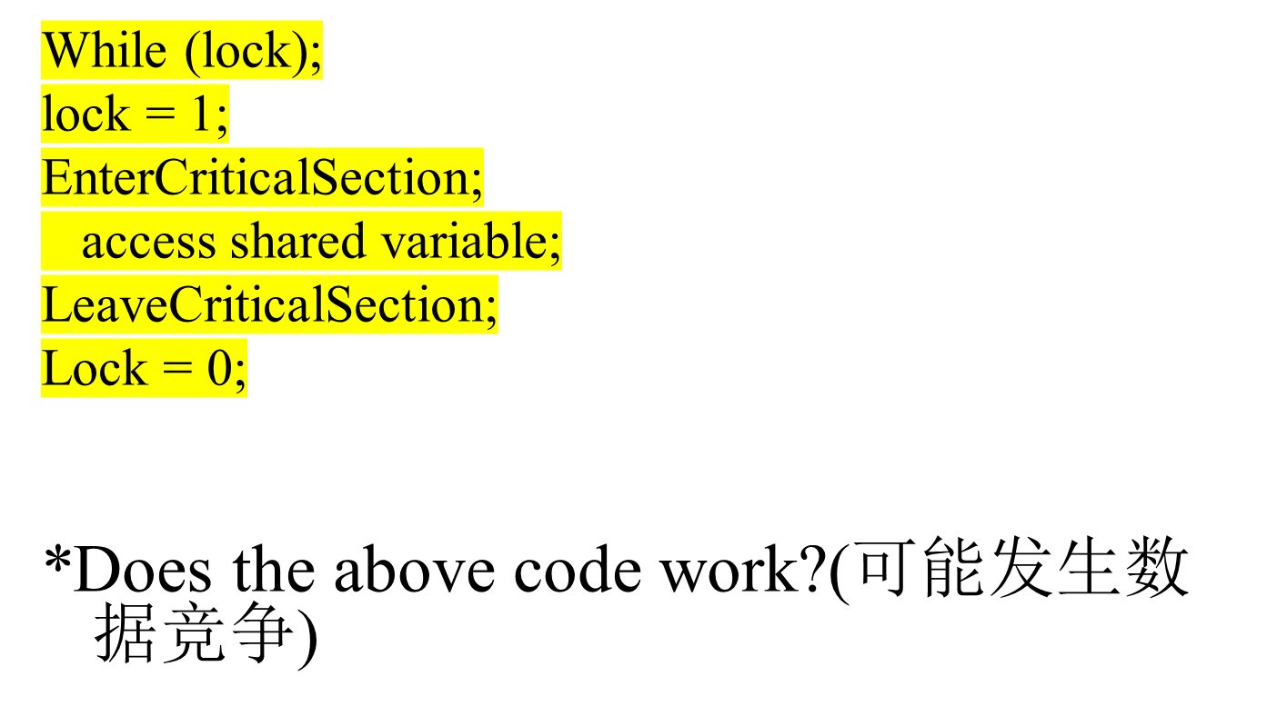

Lock Variables
*调度其他进程P

Slide 16
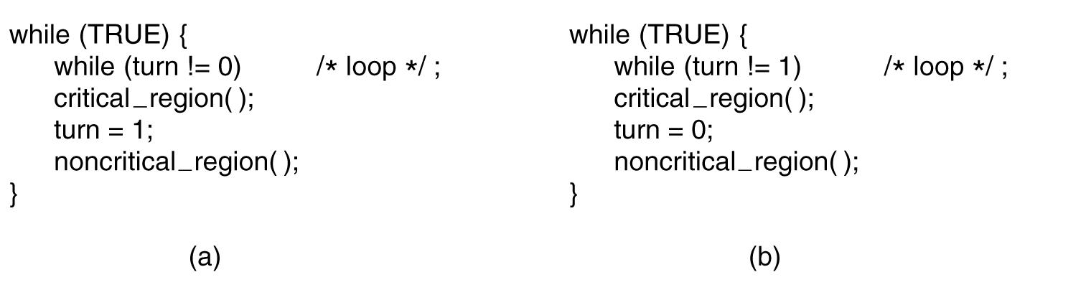
Strict Alternation（严格轮换法）
;
;
Figure 2-23. A proposed solution to the critical region problem.
(a) Process 0. (b) Process 1.
In both cases, be sure to note the semicolons terminating the while statements.
适合于执行速度相当的进程组进行轮换进入

Slide 17
Strict Alternation
Thread Me; /* For two threads */
{
while (true)
{ while ( turn != my_thread_id) { };
Access shared variables; // Critical Section;
turn = other_thread_id;
Do other work
}
}
Satisfies mutual exclusion but not progress.
Why? (当一个进程比另个进程慢得多的情况下)

Slide 18

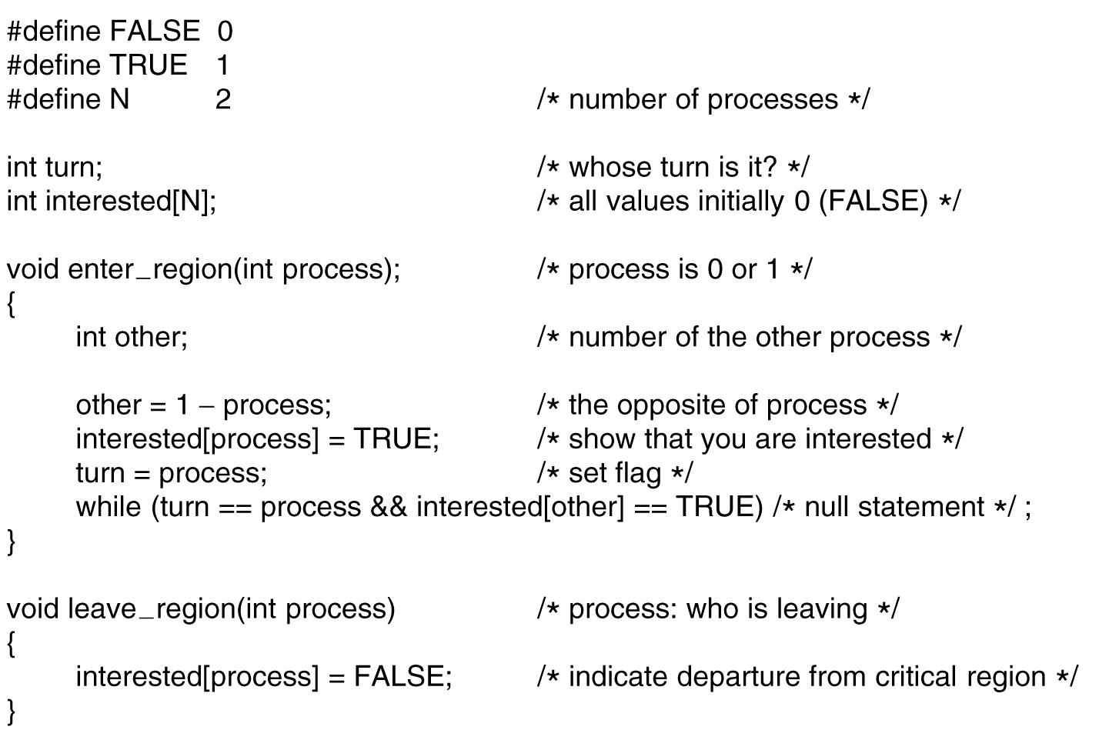


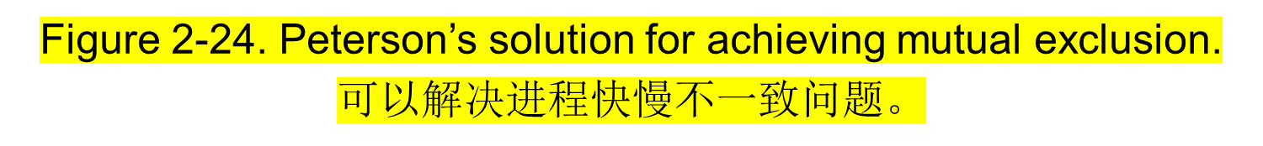

Slide 19
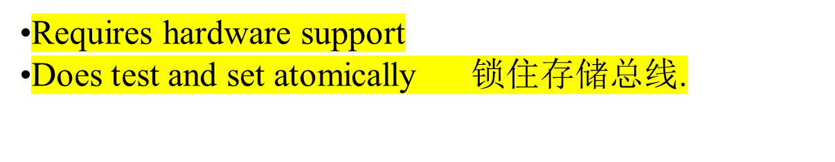
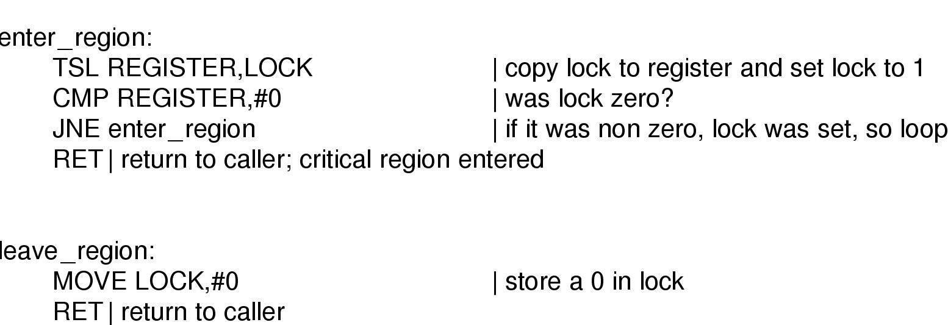
TSL instruction

Slide 20
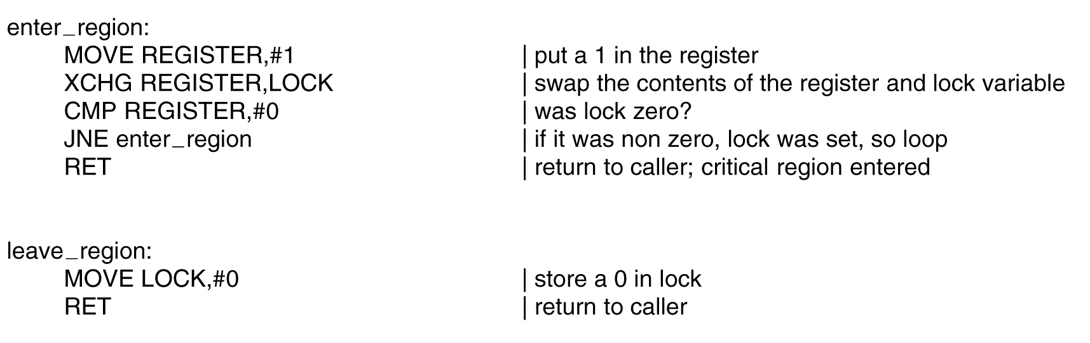
The TSL Instruction
----using the XCHG instruction (X86 CPU).
Figure 2-26. Entering and leaving a critical region
using the XCHG instruction.

Slide 21
Sleep and Wakeup
Problem with previous solutions
  Busy waiting
  Wasting CPU
  Priority Inversion:
    a high priority waits for a low priority to leave the critical section
    the low priority can never execute since the high priority is not blocked.
Solution: sleep and wakeup
  When blocked, go to sleep
  Wakeup when it is OK to retry entering the critical section

Slide 22
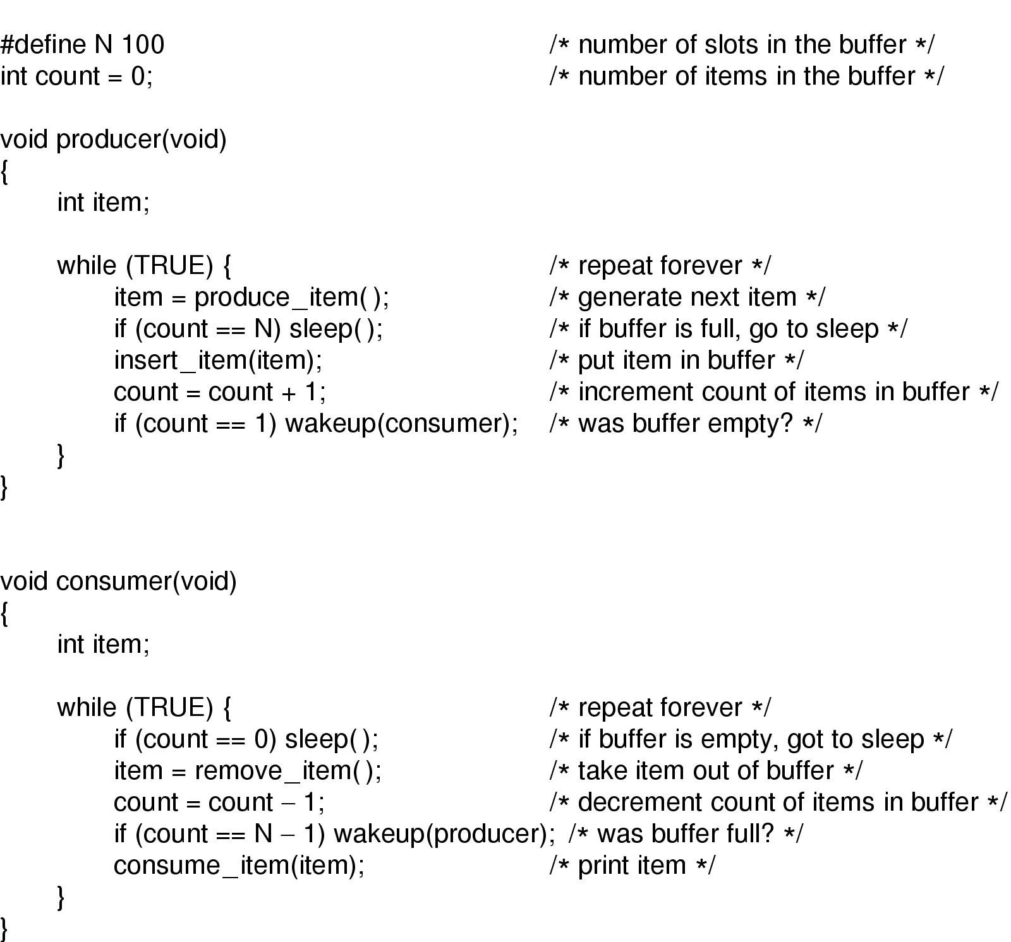
Producer-Consumer Problem (Problem?)

Slide 23
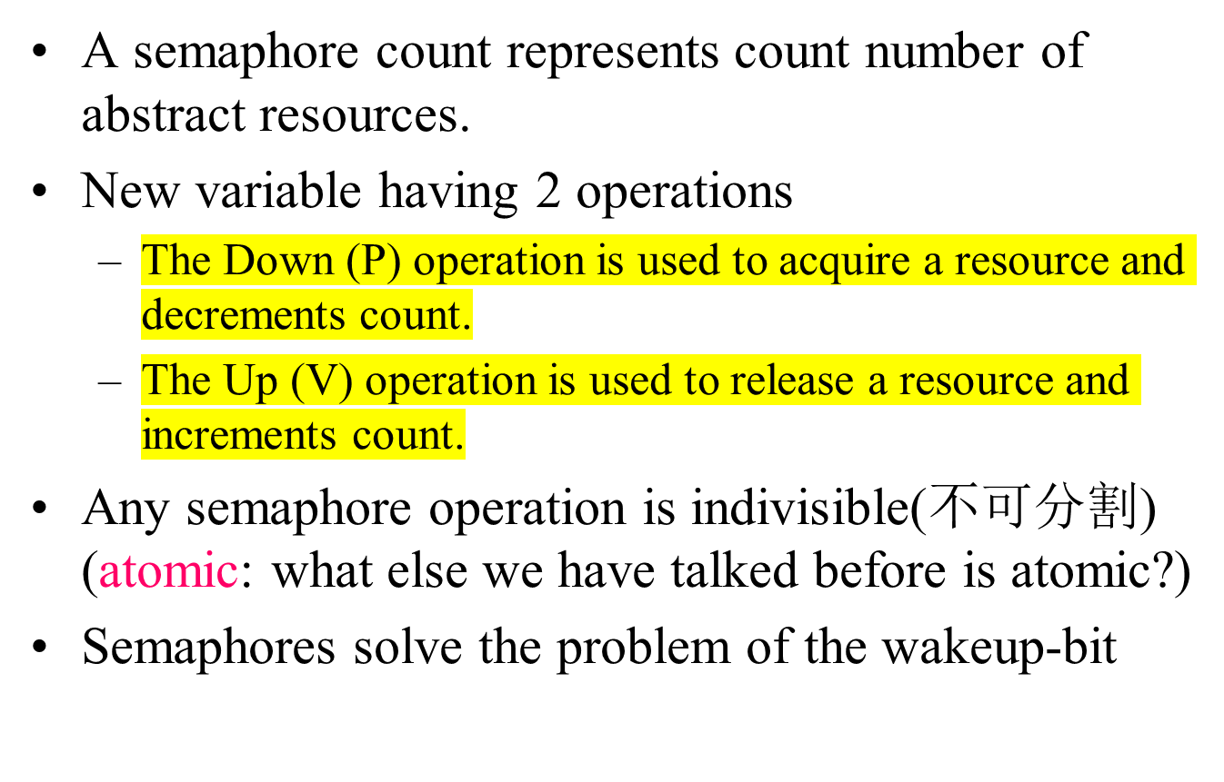
Semaphores

Slide 24
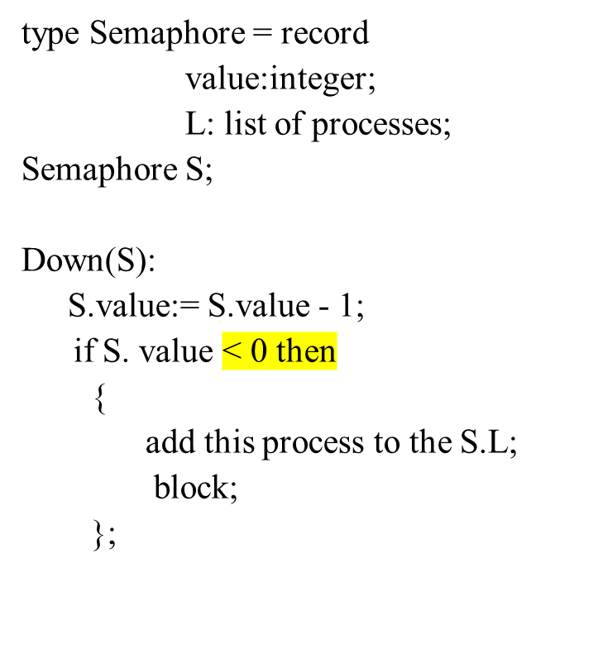
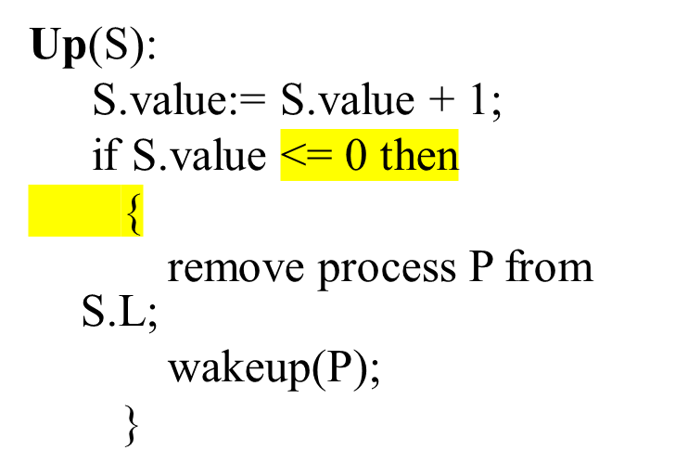
Implementations of Semaphore using Sleep & Wakeup
Does it work?

Slide 25
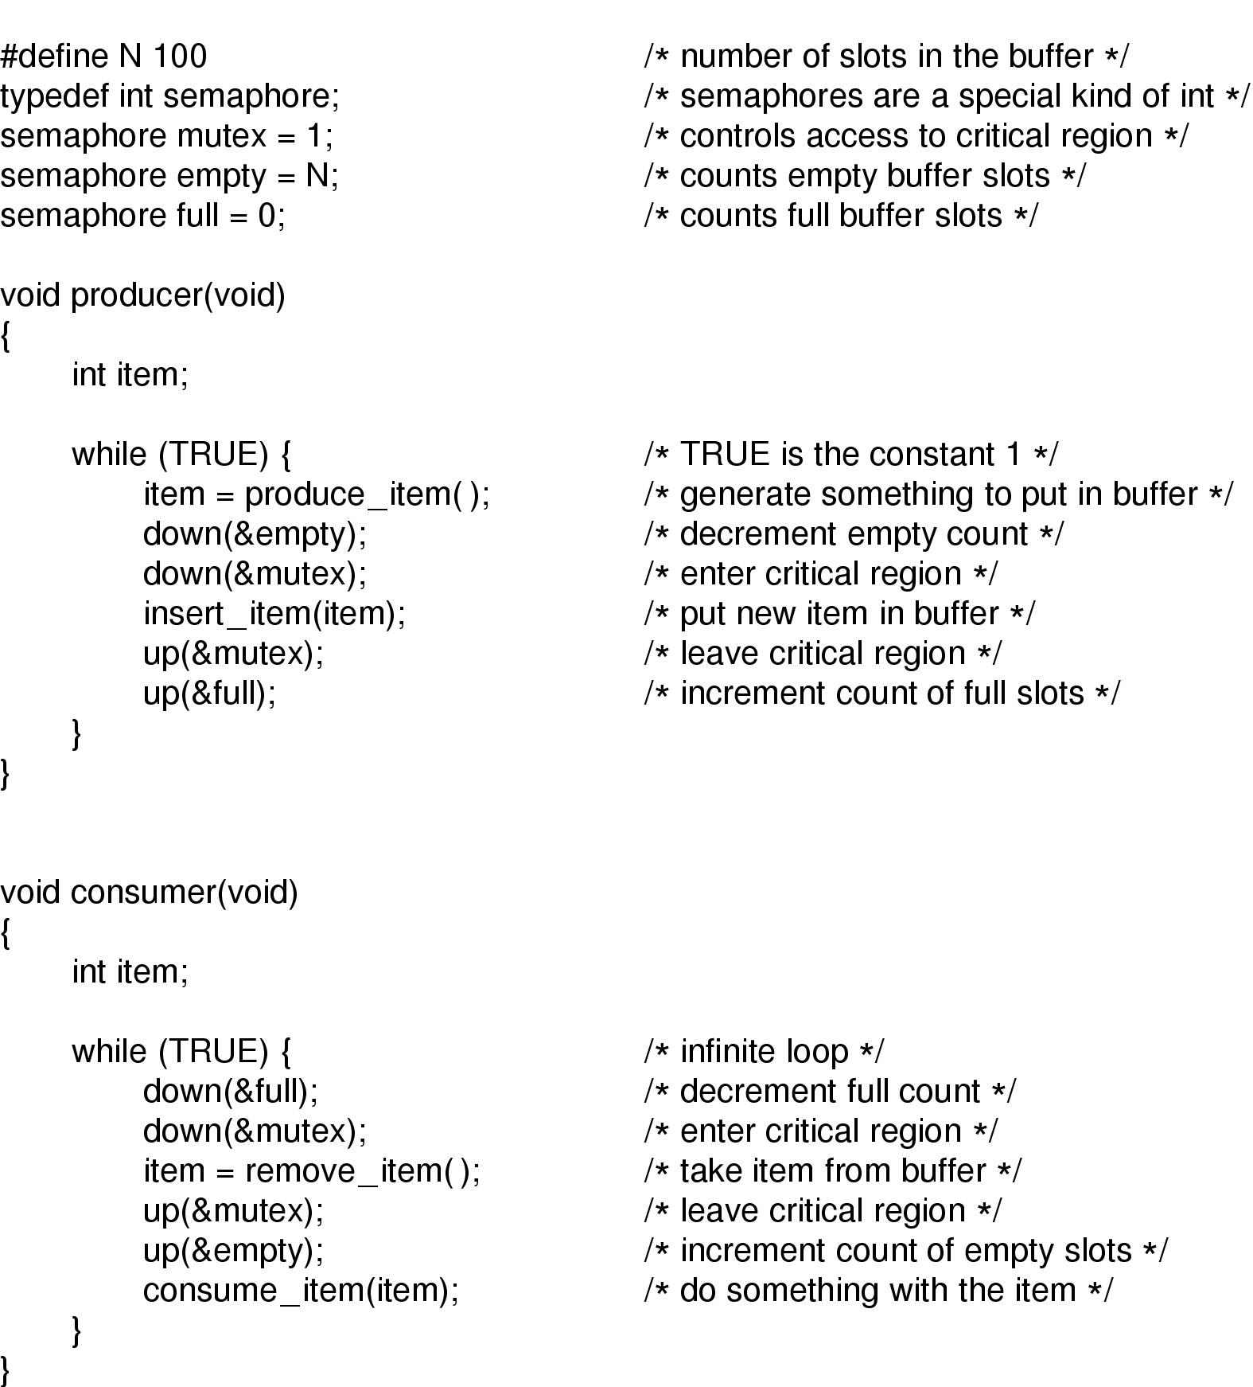
Producer-Consumer Problem using Semaphores

Slide 26

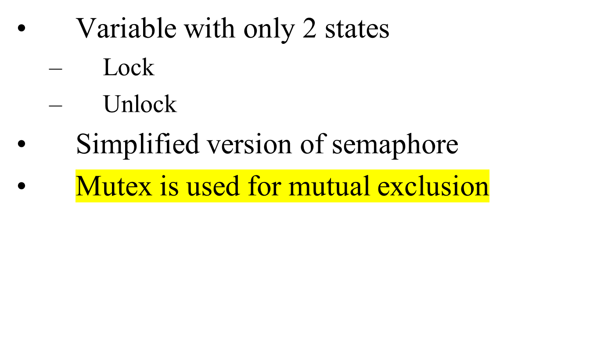

Slide 27
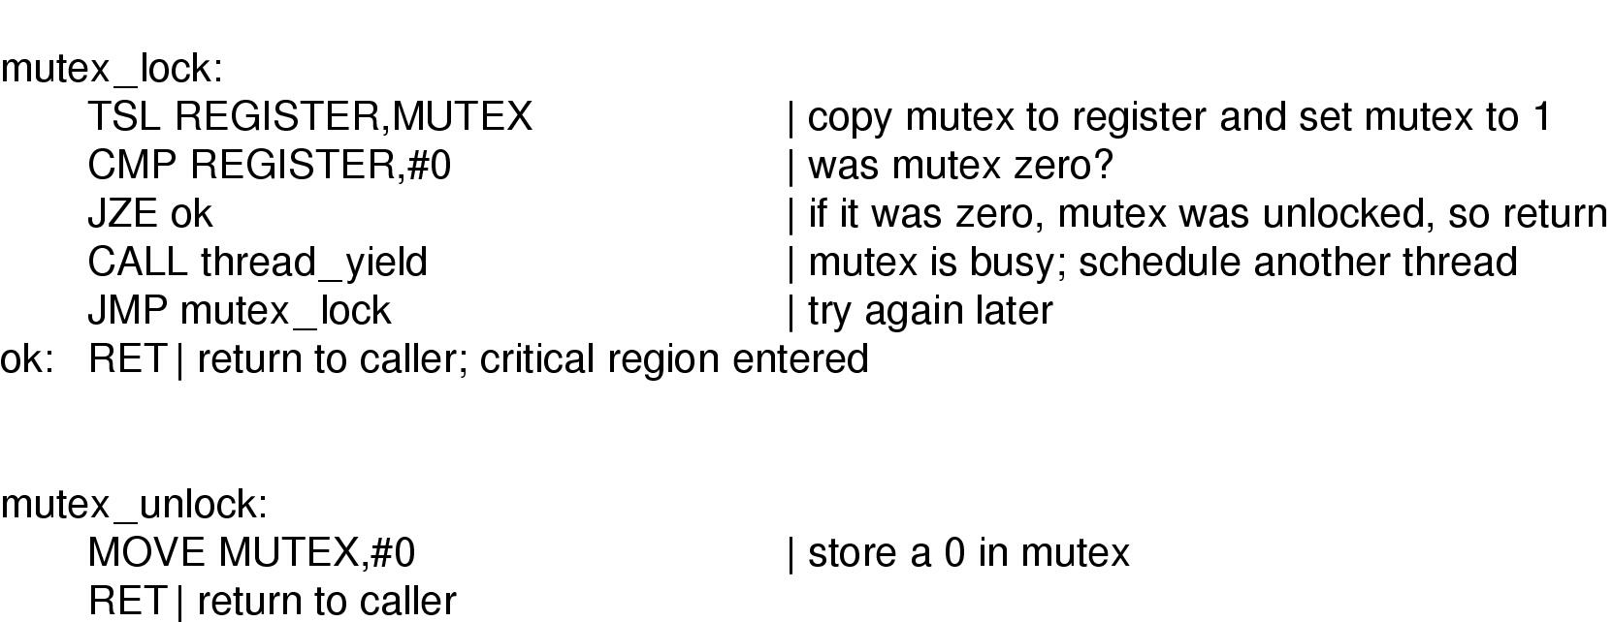
Mutex Implementation using TSL
Implementation of mutex_lock and mutex_unlock
mutex_lock与2-25enter_region很相似

Slide 28
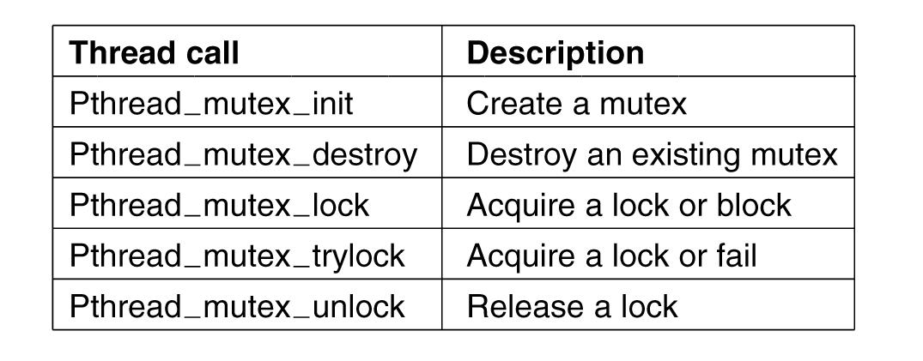
Mutexes in Pthreads (1)
Figure 2-30. Some of the Pthreads calls relating to mutexes.

Slide 29
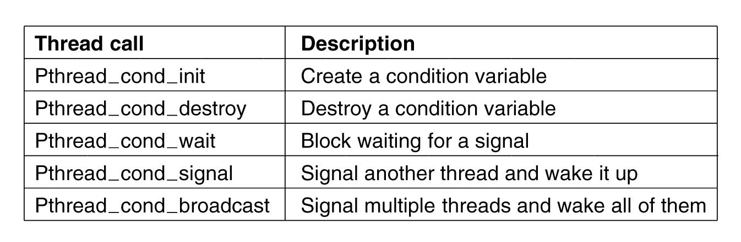
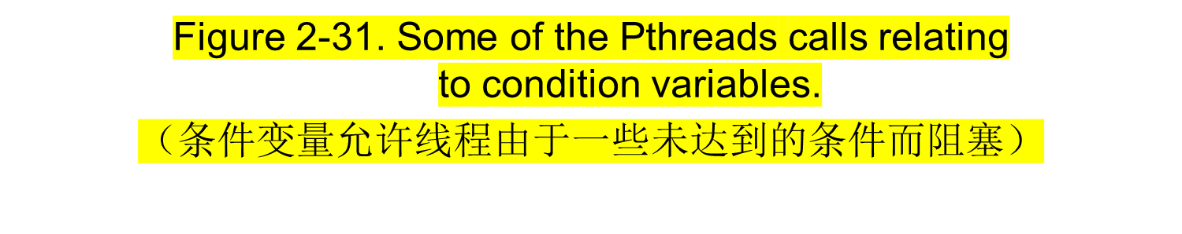
Mutexes in Pthreads (2)

Slide 30

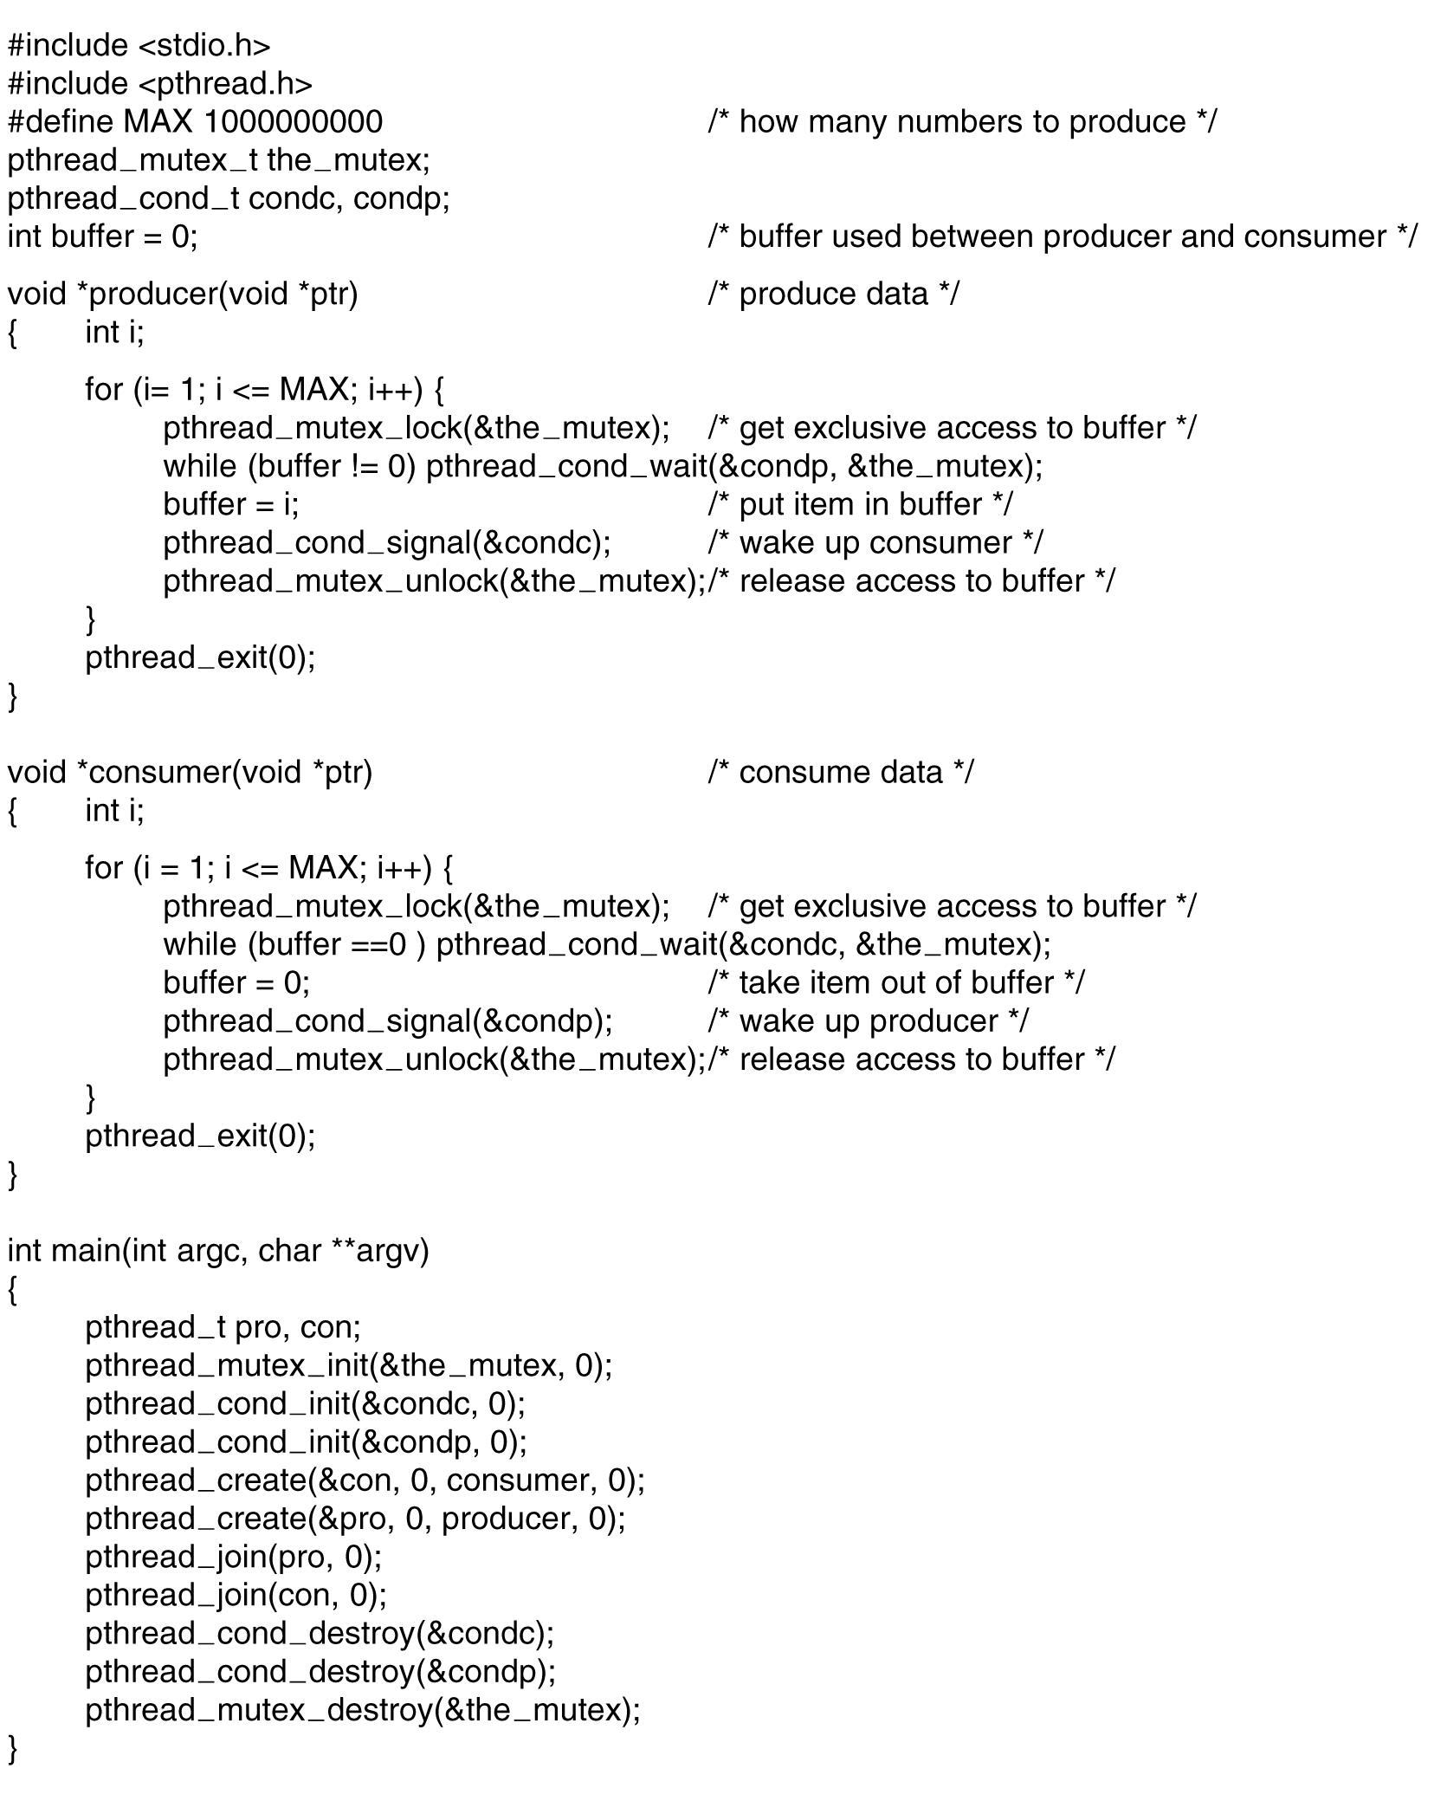

. . .

Slide 31
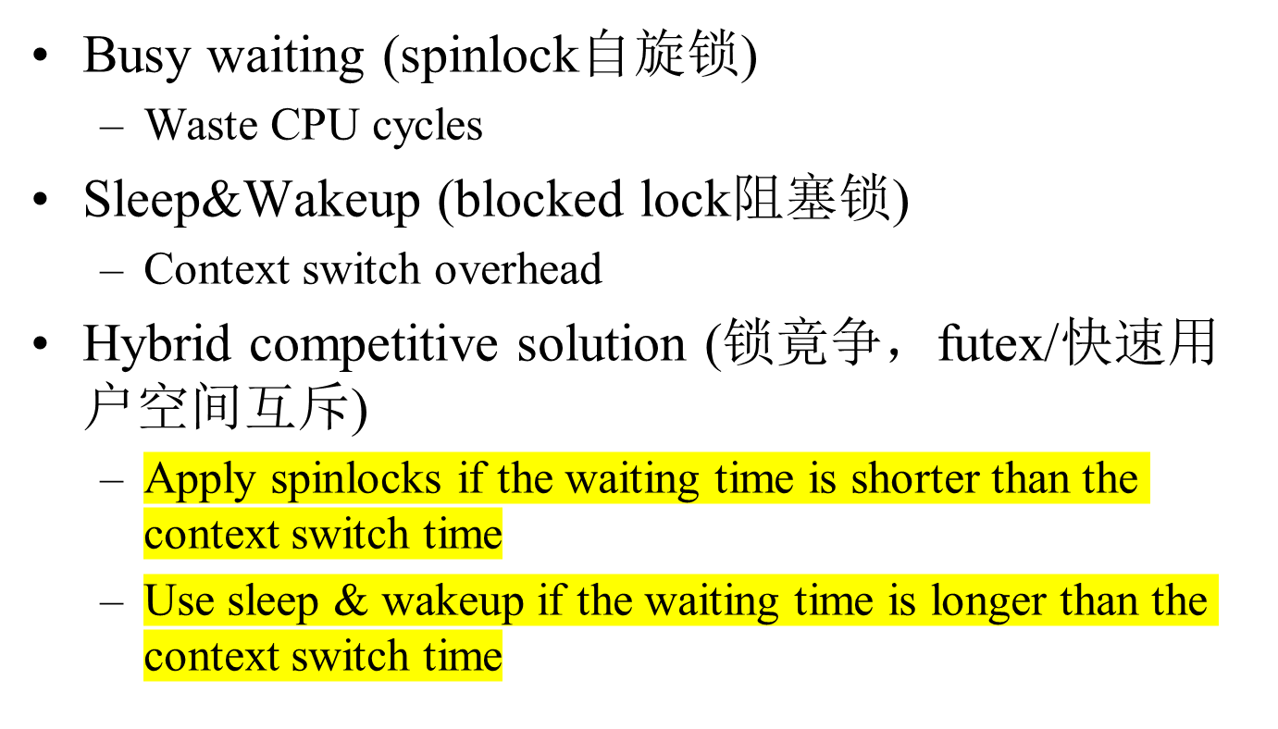
Tradeoffs

Slide 32
Producer-Consumer Problem using Semaphores

Slide 33
Possible Deadlocks with Semaphores
Example:
P0 P1
share two semaphores S and Q
S:= 1; Q:=1;
wait(S); // S=0 ------------> wait(Q); //Q=0
wait(Q); // Q= -1 <--------
--------------------> wait(S); // S=-1
// P0 blocked // P1 blocked
DEADLOCK
signal(S); signal(Q);
signal(Q); signal(S);

Slide 34
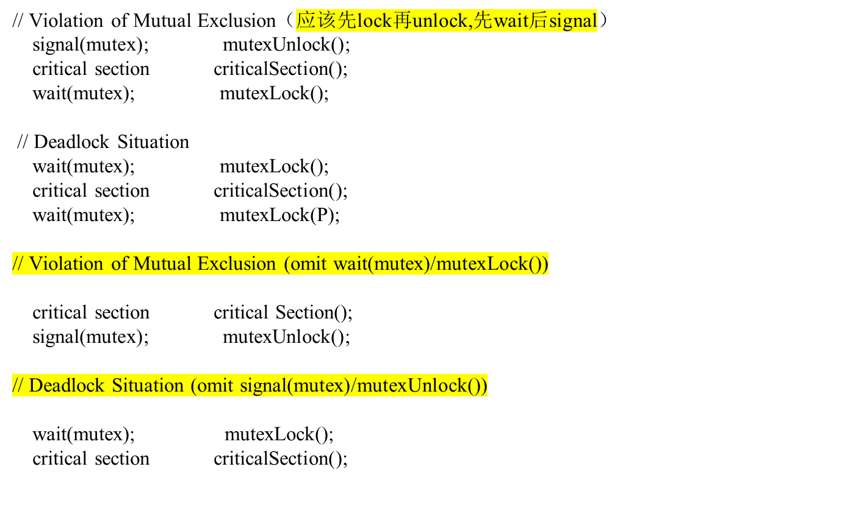




Be Careful When Using Semaphores

Slide 35
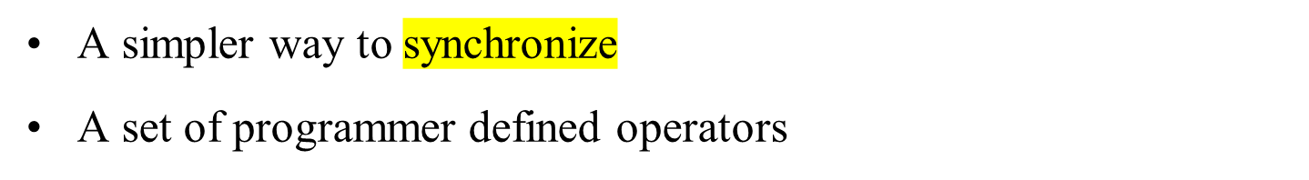
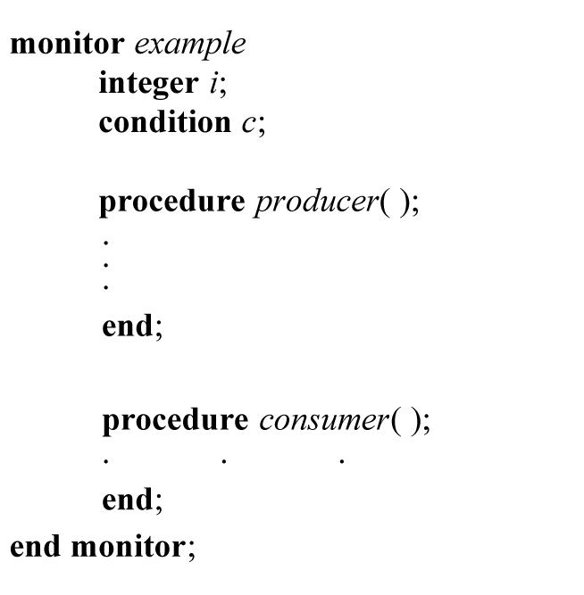
Monitor(管程)----高级的同步原语

Slide 36
Monitor Properties
The internal implementation of a monitor type cannot be accessed directly by the various threads.
The encapsulation provided by the monitor type limits access to the local variables only by the local procedures.
Monitor construct does not allow concurrent access to all procedures defined within the monitor.
Only one thread/process can be active within the monitor at a time. （互斥）
Synchronization is built in.

Slide 37
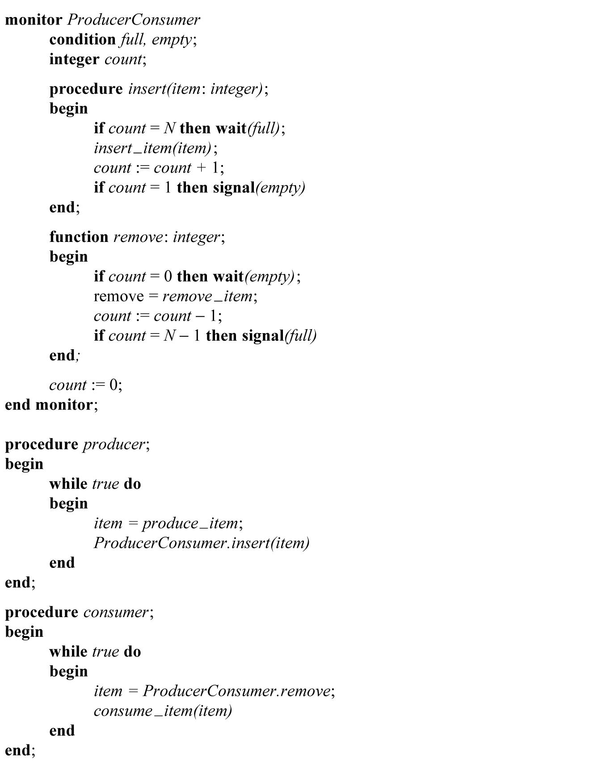
An outline of the producer-consumer problem with monitors
用Java

Slide 38
Message Passing
Send (destination, &message)
Receive (source, &message)
Message size: Fixed or Variable size.
Real life analogy: conversation

Slide 39

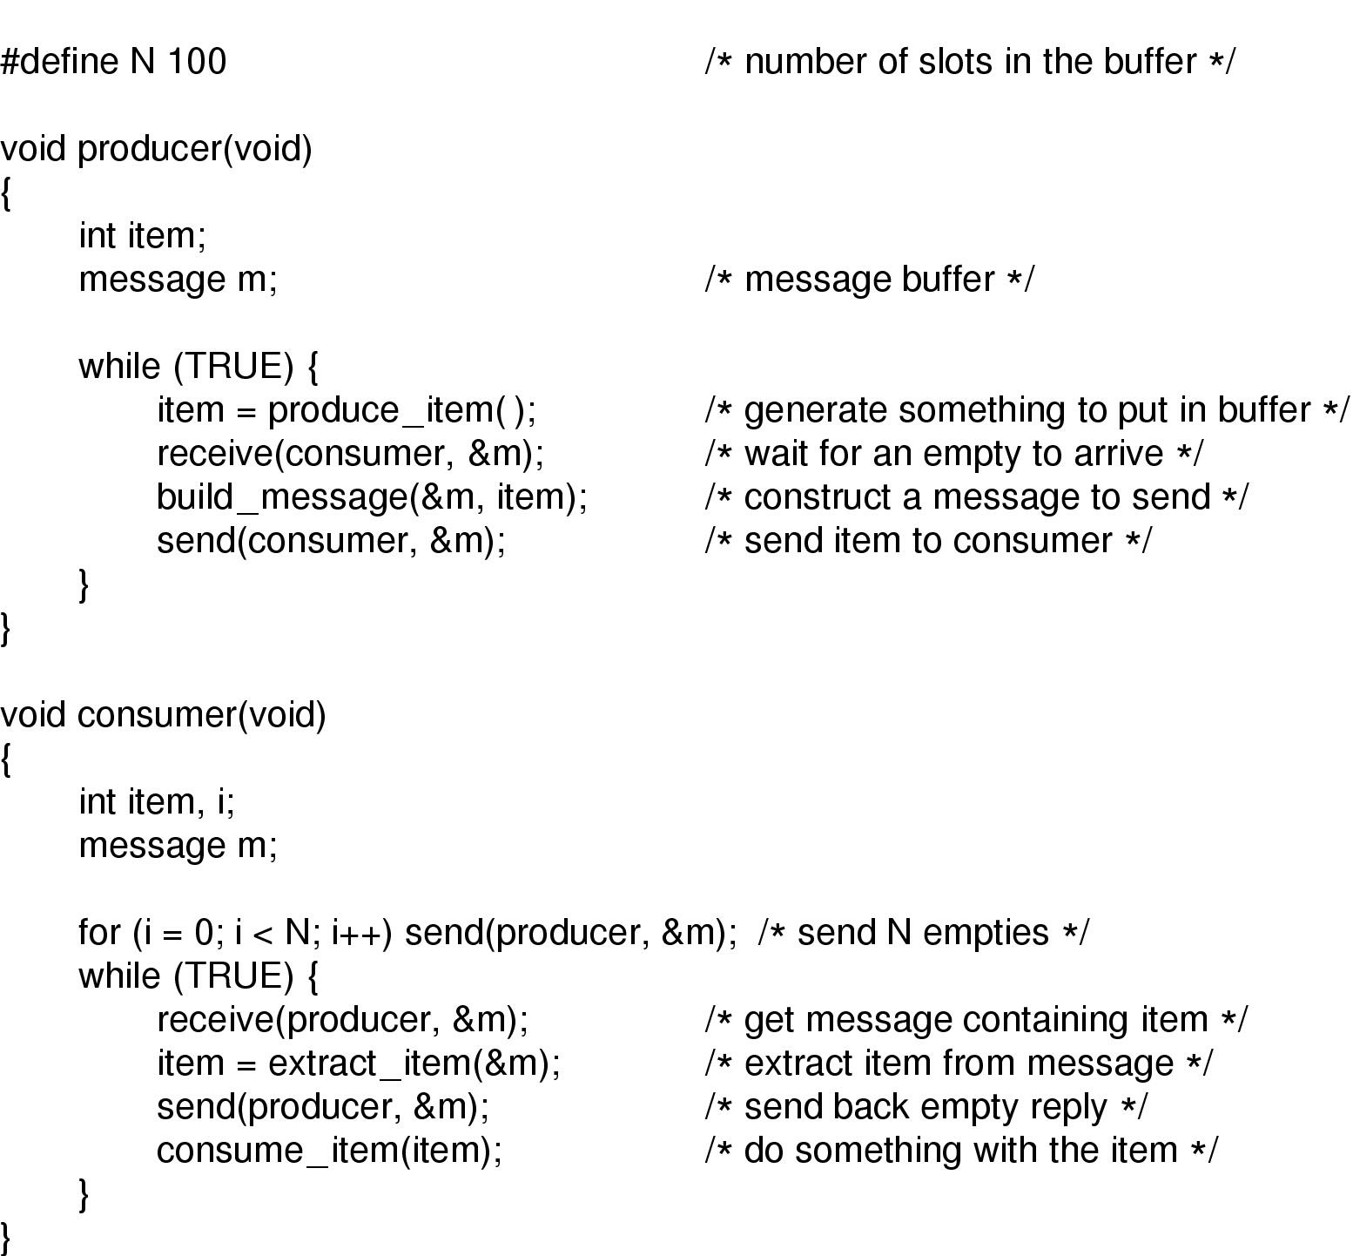

Slide 40
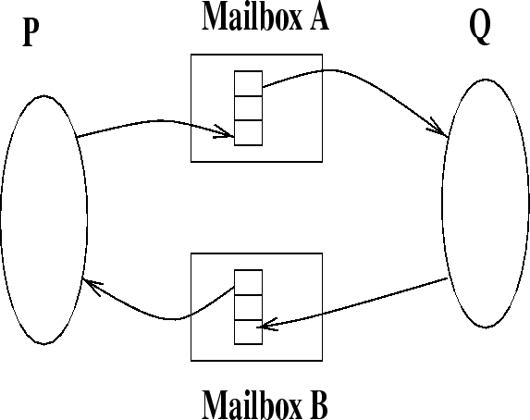
Indirect Communication
send(A,message) /* send a message to mailbox A */
receive(A,message) /* receive a message from mailbox A */
Mailbox is an abstract object into which a message can be placed to or removed from.

Slide 41
Advantage with Indirect Communication
Allows greater variety of schemes:
  two processes per link
  1 link per pair processes
  uni or bidirectional
  allow 1 process to receive a message from a link
  allow 1 process to all receive a message from a link

Slide 42
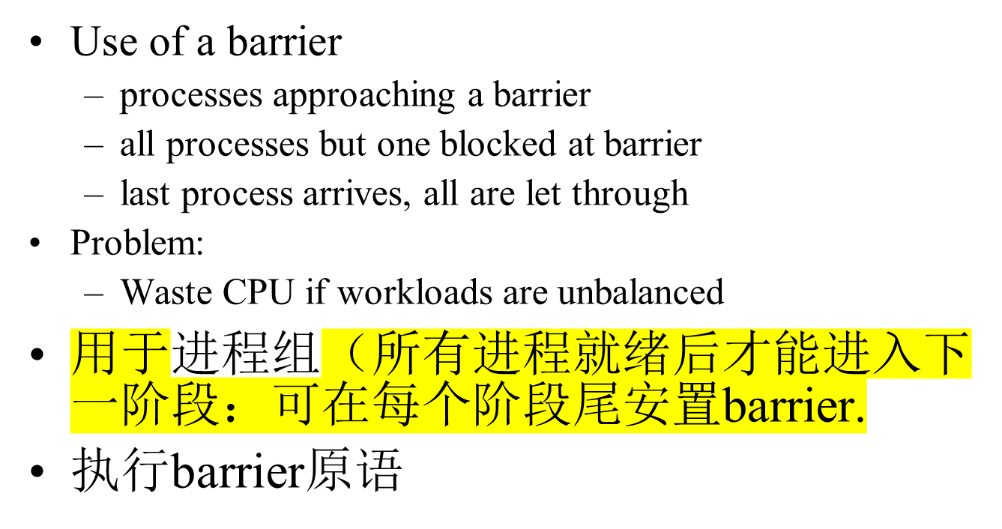
Barriers(屏障)

Slide 43
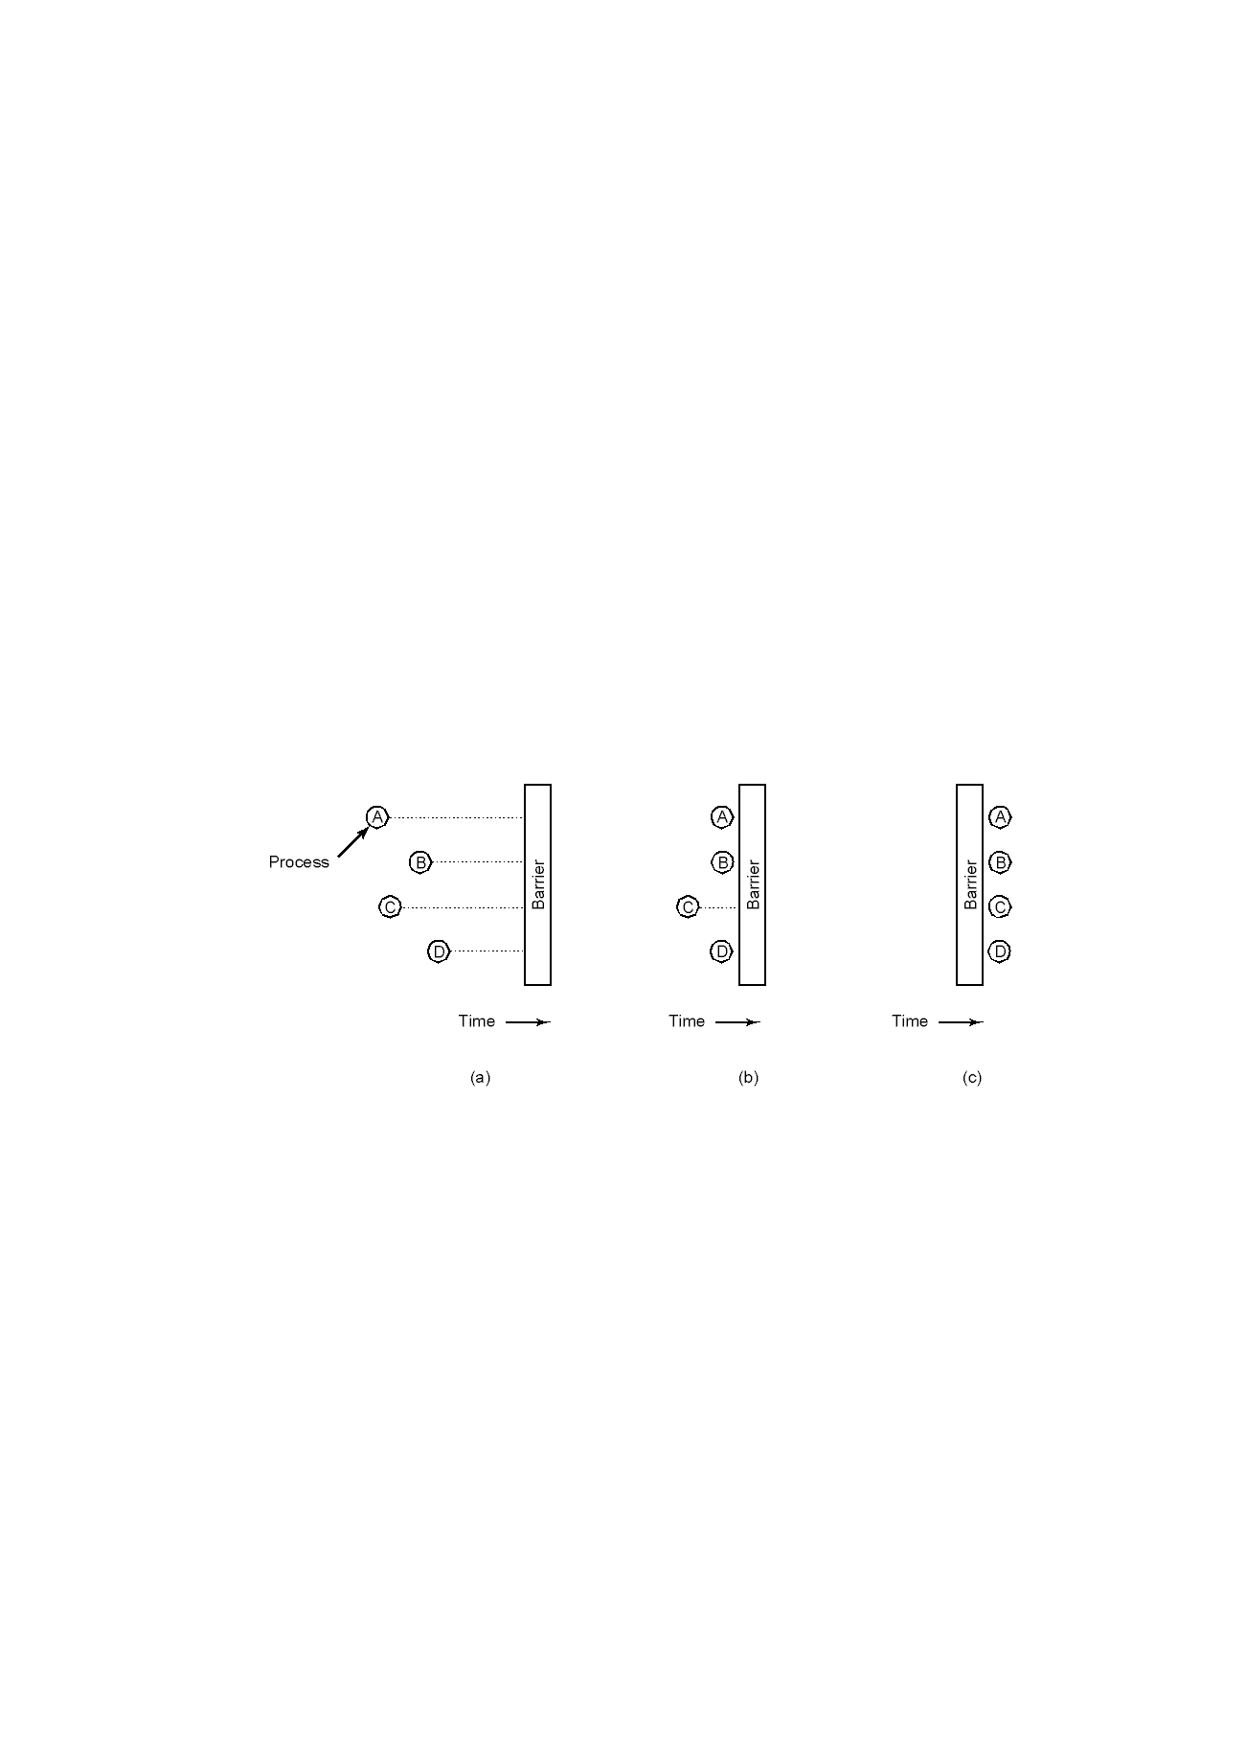
Barriers

Slide 44
Classic Problems
Producer-Consumer problem
Bounded buffer problem(环型缓冲问题)
First Reader-writer problem(读者写者问题)
Dining philosophers problem(哲学家就餐问题)
Sleeping Barber Problem(睡眠理发师问题)

Slide 45
First Reader-Writer Problem
A reader: read data
A writer: write data
Rule:
  Multiple readers can read the data simultaneously
  Only one writer can write the data at any time
  A reader and a writer cannot in critical section together.
Locking table: whether any two can be in the critical section simultaneously
Group discussion (2 minutes)
Does it work? Why?
What if ?
Problem with this solution
 | Reader | Writer
Reader | OK | No
Writer | NO | No

Slide 46

Semaphore mutex, wrt; // shared and initialized to 1;
int readcount; // shared and initialized to 0
// Writer // Reader
Down(mutex);
readcount:=readcount+1;
Down(wrt); if readcount == 1 then Down(wrt);
...... Up(mutex);
writing performed ....
..... reading performed
Down(mutex);
Up(wrt); readcount:=readcount-1;
if readcount == 0 then Up(wrt);
Up(mutex);

Slide 47

Dining Philosophers: an intellectual game
Philosophers eat/think
Eating needs 2 forks
Pick one fork at a time
Possible deadlock?
How to prevent deadlock?

Slide 48
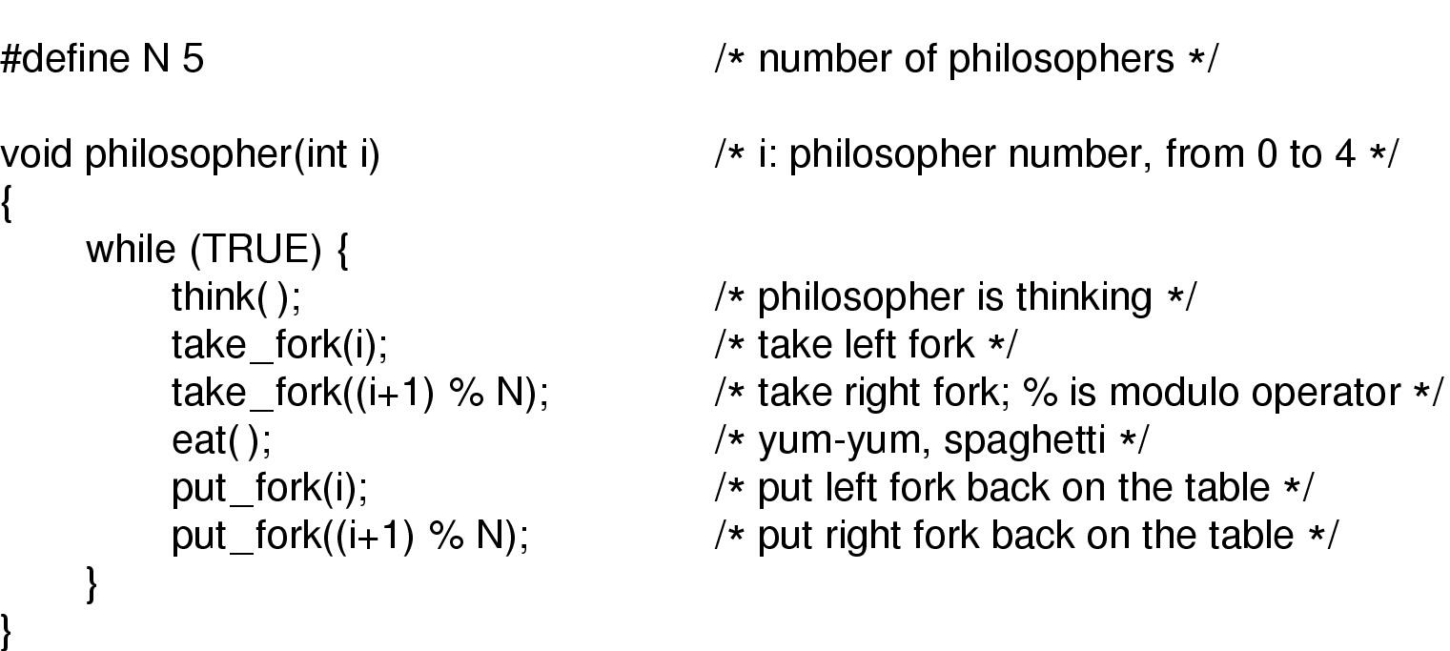
Does it solve the Dining Philosophers Problem?
A nonsolution to the dining philosophers problem

Slide 49
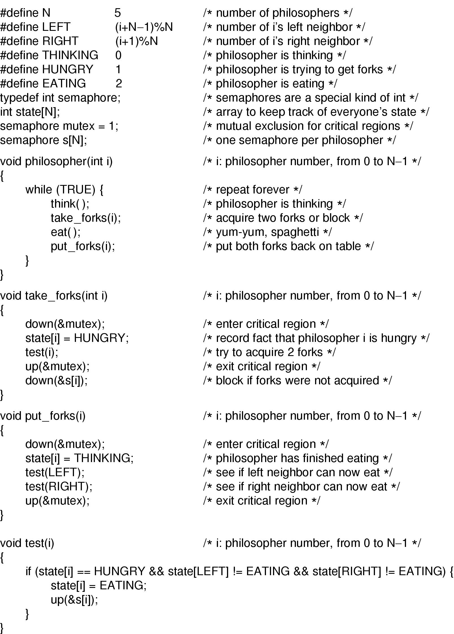
Dining Philosophers Solution

Slide 50
Dining Philosophers Solution

Slide 51
Summary
Data Races
Critical regions
Mutual exclusion using busy waiting
Sleep and Wakeup
Semaphores
Mutexes
Monitor
Passing Message
Barrier (屏障）
Classic synchronization problems

Slide 52
After this lecture
Reading assignment: chapter 2
Start next week with Chapter 6
Homework:
  P98-P101:1, 10,11,15,16,43,44,45,49,50,
  54,55

